Slide 1
China and the Middle-Income Trap

Slide 2

The problem
Notes:
In the last 20 years, China has been emerging as one of the biggest economy of the world, with some metric having it as the larget economy of the world. However, it is going through some major issues in the future. Based on the current data, both demographic and other economic metrics along with comparison with other countries, will China beat the middle income trap?

Slide 3

Target audience
Notes:
This data will be useful for policy makers and investors that have tie to China.

Slide 4
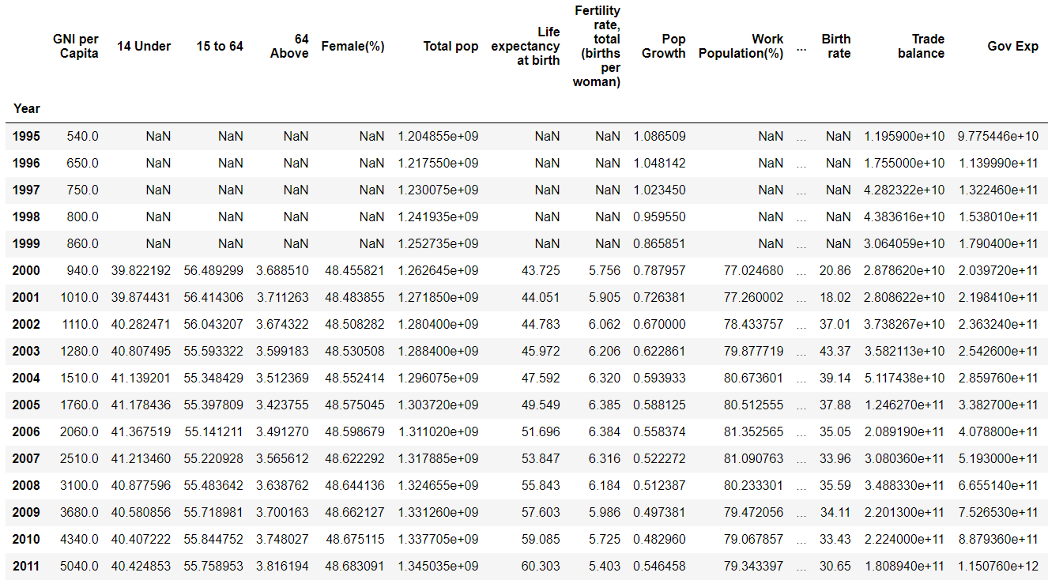
Data
https://data.worldbank.org/
Notes:
The data is from World Bank

Slide 5
Data Wrangling
Took each potential dataset from World Bank
Each feature data had over 200 countries with 60 years
Each feature data was combined into one country
All data ranged from 1960 to 2020

Slide 6
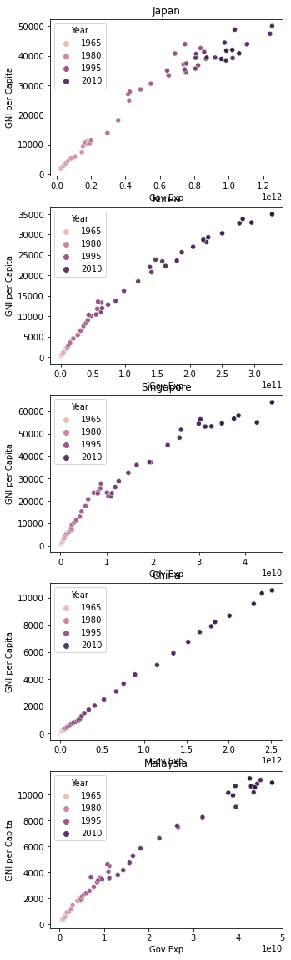
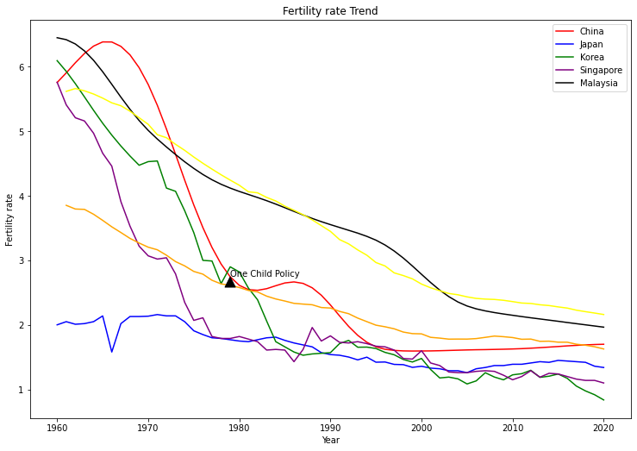
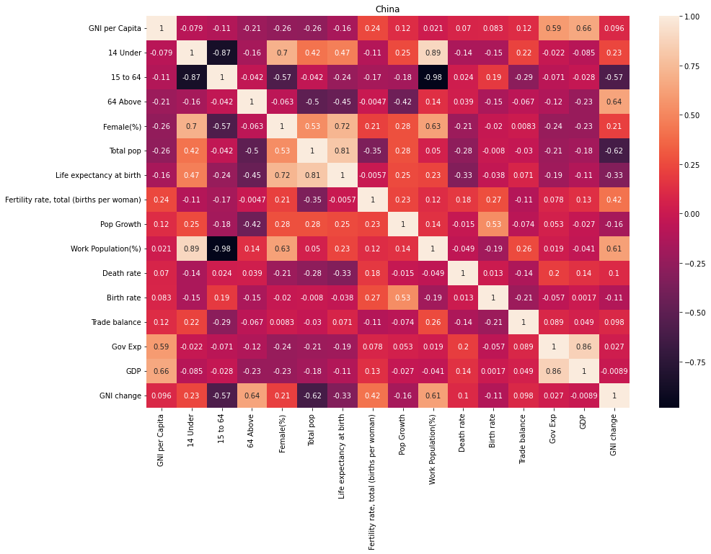
EDA
Notes:
Looked through the basic trend in each country if there any similar patterns.
Then looked to see if each pattern had any correlations. Utilizing heatmap, try to see correlations through the features but had to covert to pct change between the years. What I found was two things, demographic shift is not a good way to measure annual economic changes and strong correlation between GDP and government spending and GNI.

Slide 7
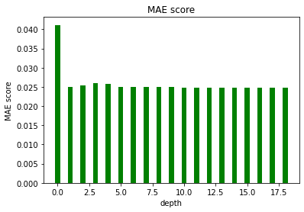
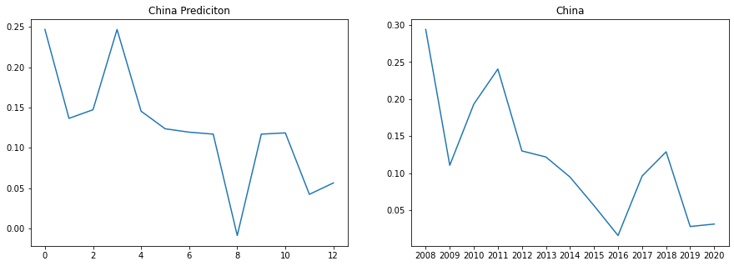
Modeling
Random Forest
Gradient
KNN Regressor

Slide 8
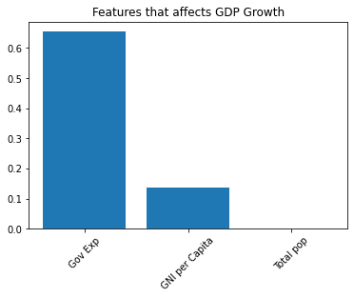
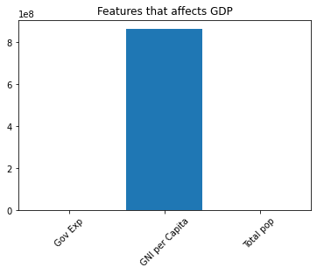
Features
Notes:
Demographic again demonstrate that it is not the ideal way to measure annual economic growth.

Slide 9
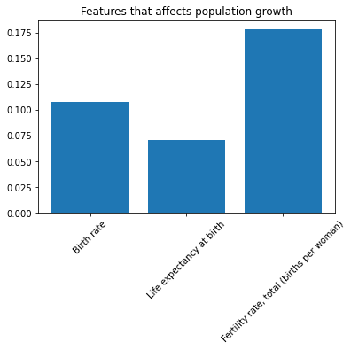
Notes:
However, for population growth, Fertility Growth had the strongest relationship.

Slide 10
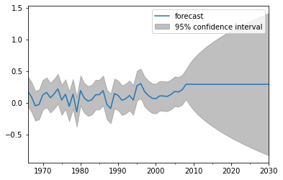
Time Series
Notes:
Taking our model into ARMA model, it’s likely that the GDP growth change will stay around and not likely to increase too much.

Slide 11
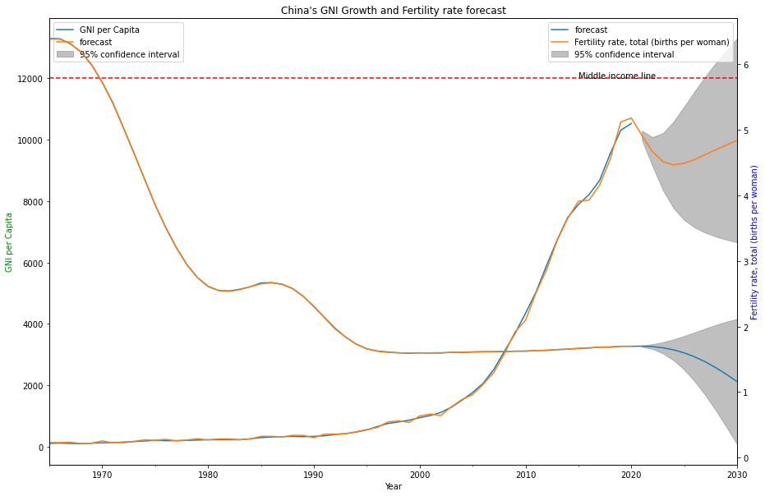
Time series forecast
Notes:
Using ARIMA model, it seems likely that China’s economic growth will not beat the middle income trap.

Slide 12
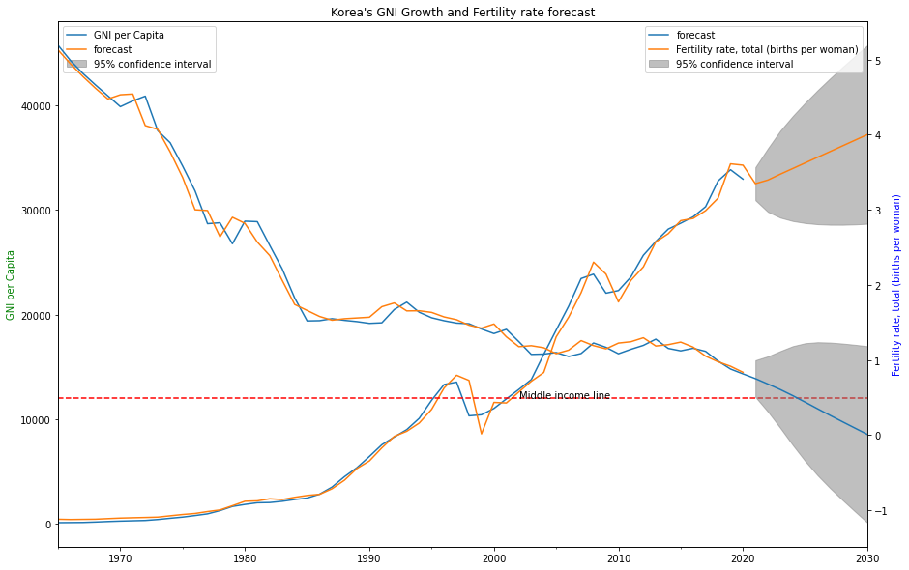
Looking at other countries
Notes:
Other countries did beat the middle income trap despite having fertility rate being lower.

Slide 13
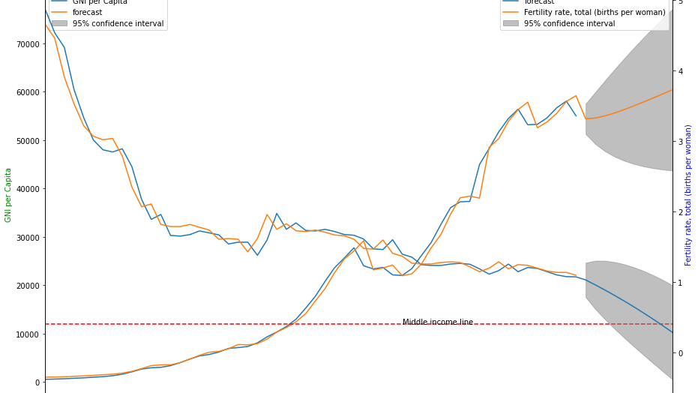
Looking at other countries
Notes:
Same with Singapore, so there could be some positive sign for China in the future. Nevertheless, it’s a worrying sign that fertility rate of China will go down in the near future.

Slide 14
Takeaways
Demographic trend is not ideal at measuring economy on year to year, despite having high correlation.
For China, government spending is a great way to look at its GDP growth.
Based on the ARIMA model, China is not likely to break the middle-income trap.
Fertility rate had the highest importance on seeing population growth.
The Fertility rate will be a worrying sign for China.

Slide 15
Future Research
A way to connect demographic and economy. Maybe delayed demographic data.
Instead of Asia look at other countries.
Incorporate how COVID could affect this trend.

